Slide 1


A MULTI LABEL GENRE CLASSIFICATION MODEL OF GOODREADS BOOK SELECTION
THROUGH THE GENRE GLASS

Slide 2







Book Authors
Book Authors
Book Descriptions
Book Title
ABOUT THE DATA
Pages
GENRES
Edition, Format, ISBN, Rating, Rating Count, Review Count, Image URL

Slide 3
Multiple target columns
Feature 1 | Feature 2 | Feature 3 | Feature 4 | Target 1 | Target 2 | Target 3
ABOUT MULTILABEL

Slide 4



THE PROBLEM
1400+
Genres in GoodReads Library
Genres in GoodReads Library
866
Starting Data Genres

Slide 5

THE SOLUTION
30, 000+
Genres in GoodReads Library
MACHINE PREDICTED
Starting Data Genres

Slide 6
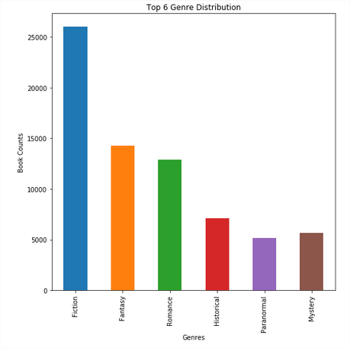
SAMPLE SIZE
GENRE DISTRIBUTIONS
95 Confidence Interval
1 Margin Error
1500
Minimum: 385
AUTHOR
STATISTICS
Most: 1 - 3
Maximum: 51

Slide 7

FEATURE DESCRIPTION
ONE HOT ENCODE AUTHORS
Each Author as one feature (1 or 0)
TFIDF BOOK TITLE + DESCRIPTION
SCALED NUMBER OF PAGES
FICTION, FANTASY, ROMANCE, HISTORICAL, PARANORMAL, MYSTERY
6 Targets = Top 6 Genres

Slide 8
INPUT CLASSIFIER MODEL
MACHINE LEARNING: ONEVSRESTCLASSIFIER
ITERATE OVER LABELS
Summary of Each Target Accuracies
Type | Fiction | Fantasy | Romance | Historical | Paranormal | Mystery
PCC | 65.31 | 51.32 | 58 | 68.48 | 75.35 | 82.32
Logistic Regression | 78.13 | 63.20 | 73.33 | 80.53 | 85.87 | 91.47
SVM | 78.13 | 63.20 | 73.33 | 80.53 | 85.87 | 91.47
SVC | 77.87 | 63.47 | 73.33 | 80.53 | 85.87 | 91.47
Naïve Bayes | 78.13 | 63.20 | 72.8 | 80.8 | 85.87 | 91.47
Validation | 65.53 | 56.27 | 65.27 | 84.2 | 83 | 87.33
OUTPUT ACCURACY SCORES
TRAIN MODEL
VALIDATE

Slide 9
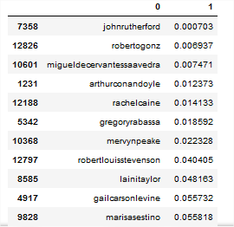
Book Authors
Top Features

Slide 10
Multi Tagging
Extension
Classify the theme or topic of journals, or products
Specificity check
More core power for larger datasets for better validations

